Slide 1
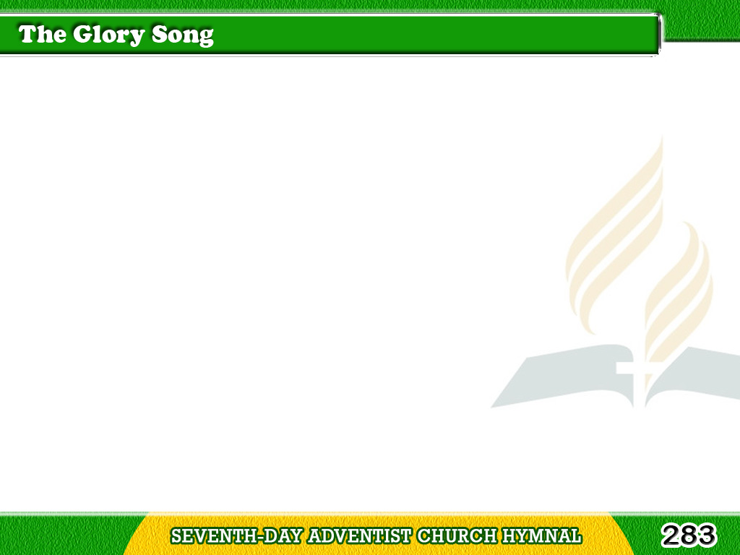
1/3
When all my labors
and trials are o’er,
And I am safe on
that beautiful shore,
Tagalog
Version

Slide 2
1/3
Just to be near
the dear Lord I adore,
Will through the ages
be glory for me.
Tagalog
Version

Slide 3
1/3
Chorus
O that will be
glory for me,
Glory for me,
glory for me;
Tagalog
Version

Slide 4
1/3
Chorus
When by His grace
I shall look on His face,
That will be glory,
be glory for me.
Tagalog
Version

Slide 5
2/3
When, by the gift
of His infinite grace,
I am accorded
in heaven a place,
Tagalog
Version

Slide 6
2/3
Just to be there
and to look on His face,
Will through ages
be glory for me.
Tagalog
Version

Slide 7
2/3
Chorus
O that will be
glory for me,
Glory for me,
glory for me;
Tagalog
Version

Slide 8
2/3
Chorus
When by His grace
I shall look on His face,
That will be glory,
be glory for me.
Tagalog
Version

Slide 9
3/3
Friends will be there
I have loved long ago;
Joy like a river
around me will flow,
Tagalog
Version

Slide 10
3/3
Yet, just a smile
from my Savior, I know,
Will through the ages
be glory for me.
Tagalog
Version

Slide 11
3/3
Chorus
O that will be
glory for me,
Glory for me,
glory for me;
Tagalog
Version

Slide 12
3/3
Chorus
When by His grace
I shall look on His face,
That will be glory,
be glory for me.
Tagalog
Version

